Slide 1

Final Project
Submitted by: Jay Panchal
Student Id: 100960958

Slide 2


Agenda
Problem Statement
Dataset Overview
Goal
EDA Insights
Logistic Regression Learning Curve
Naive Learning Curve
Classification Report Analysis for Optimized Models
Performance of the Voting Model
Recommendations for Mr. John Hughes
Next Steps

Slide 3

Problem Statement
Mr. John Hughes has tasked us with addressing a critical business challenge: understanding and predicting customer churn using data-driven insights. Customer churn is a significant concern for the wireless service industry, as it directly impacts revenue and long-term customer relationships.
The goal is to leverage the wireless_churn.csv dataset to develop and evaluate three predictive models to forecast churn. These models will help identify customers at risk of leaving and enable the business to proactively implement retention strategies.

Slide 4
Dataset Overview
The dataset contains 3,333 observations and 11 variables:
Independent Variables:
AccountWeeks: Number of weeks the customer has had an active account.
ContractRenewal: Binary (1 = recently renewed, 0 = not).
DataPlan: Binary (1 = has a data plan, 0 = no data plan).
DataUsage: Monthly data usage in gigabytes.
CustServCalls: Number of calls made to customer service.
DayMins: Average daytime minutes used per month.
DayCalls: Average number of daytime calls per month.
MonthlyCharge: Average monthly bill in USD.
OverageFee: Largest overage fee incurred in the past 12 months.
RoamMins: Average roaming minutes used per month.
Dependent Variable:
Churn: Binary (1 = customer canceled service, 0 = customer retained).

Slide 5
Goal
Project Deliverables:
To achieve these objectives, three forecasting models will be developed and evaluated:
Logistical Regression: A widely-used statistical method for binary classification.
Naïve Bayes: A probabilistic machine learning model based on Bayes' Theorem.
Voting Ensemble: Combines multiple models to enhance predictive accuracy.
Purpose:
The insights and predictive capabilities derived from these models will empower Mr. Hughes to:
Identify customers at risk of churn.
Develop targeted interventions to improve retention.
Optimize marketing and operational strategies.

Slide 6
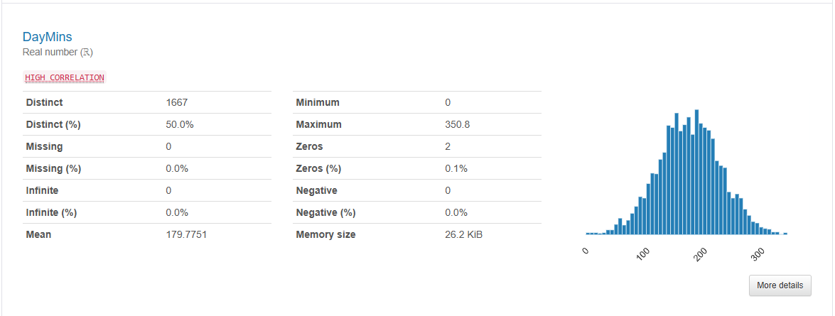
EDA Insights
Key Metrics:
Mean: ~179.78 minutes/day
Maximum: ~350.8 minutes/day
Distinct: 1667 unique values (50% distinctness).
Insights: The distribution is bell-shaped, suggesting that DayMins follow a normal distribution, with most customers using around 150–200 minutes daily. Outliers or customers at the high end (>300 minutes/day) may represent power users or business clients.
Actionable Insight: Create premium plans targeting power users, as they contribute significantly to revenue. Monitor usage trends for customers at the lower end (e.g., <100 minutes) and strategize to increase their engagement.

Slide 7
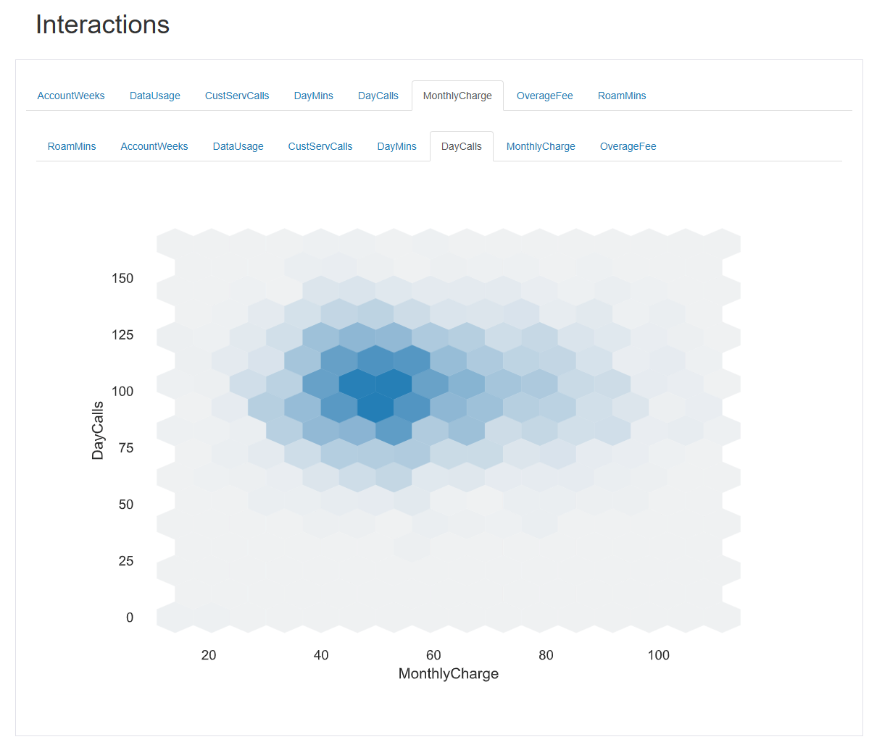
EDA Insights
Variables (Hexbin Plot) :
X-axis: MonthlyCharge
Y-axis: DayCalls
Insights: The majority of the data points are concentrated around Monthly Charges of $40–$60 and Day Calls of 75–125 calls per day.This suggests that most customers fall within this range of usage, which may represent the core user segment.There’s a noticeable decline in the density of calls for Monthly Charges above $80, indicating fewer high-paying customers with high Day Calls.
Actionable Insight: Target low-charge customers: Focus on increasing the Monthly Charges of customers in the $40–$60 range by offering tailored plans or add-ons.Upsell to high-use customers: Customers making many Day Calls could be encouraged to upgrade their plans for better benefits.

Slide 8
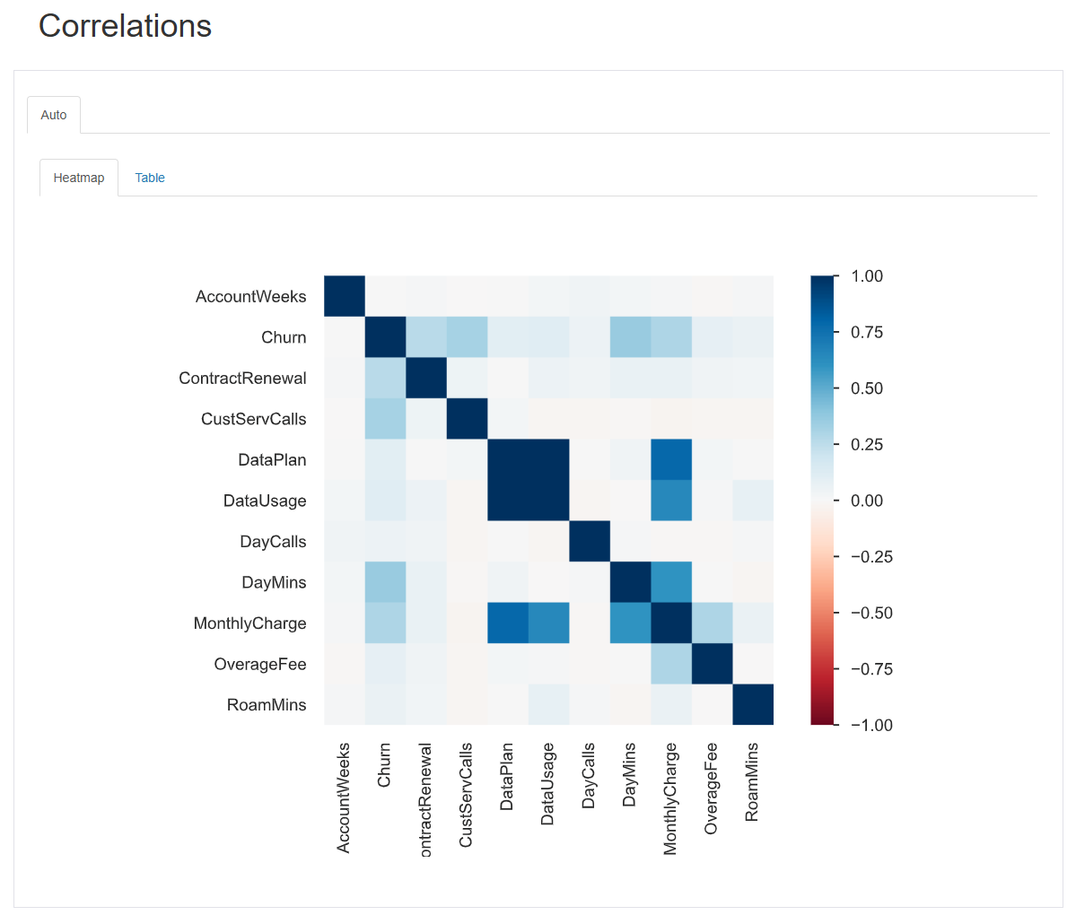
EDA Insights
Key Observations:
Strong Positive Correlations:
MonthlyCharge ↔ DayMins: Indicates that higher Monthly Charges are associated with customers who use more daytime minutes.
OverageFee ↔ MonthlyCharge: Suggests that customers incurring overage fees are also paying higher Monthly Charges, likely exceeding their plan limits.
Weak Correlations:
Some variables like CustServCalls show little correlation with features like DataUsage or DayCalls, suggesting customer service calls may not be directly tied to usage behavior.
Actionable Insight:
Monitor DayMins and OverageFees closely to predict high-value customers at risk of churn. Offer flexible plans or discounts to retain them.
Use weakly correlated features to segment customers for diverse marketing campaigns.

Slide 9
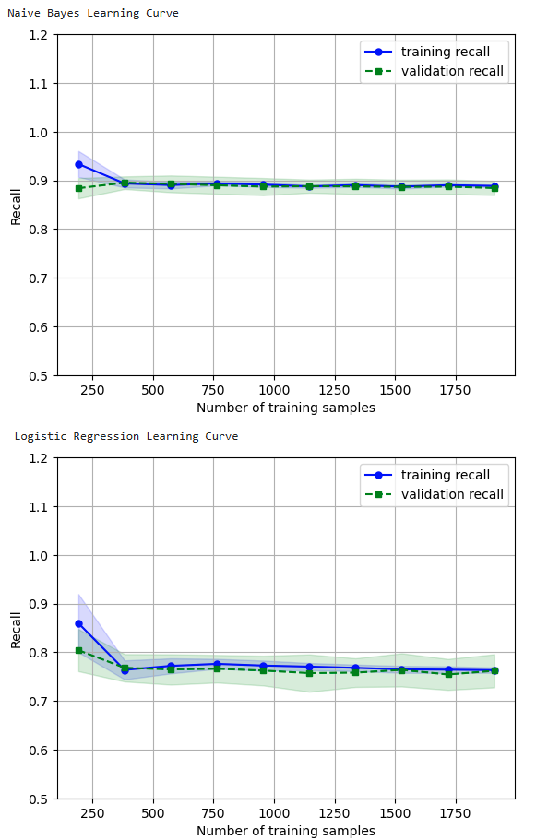
Logistic Regression Learning Curve
Training Recall Convergence:
The training recall starts higher (~0.85) with small datasets but slightly drops and stabilizes around ~0.8 as more training samples are introduced. This behavior reflects how the model adjusts its fit with increasing data, avoiding overfitting to small datasets.
Validation Recall Alignment:
The validation recall is initially slightly lower than the training recall but converges to a similar value as the training recall stabilizes. This indicates that Logistic Regression benefits from the increased data and achieves good generalization over time.

Slide 10
Naive Bayes Learning Curve
Training Recall Stability:
The training recall starts at a high level (~0.9) and remains stable as the number of training samples increases, with minimal variance. This indicates that the Naive Bayes model quickly reaches a point where additional data does not significantly improve training performance.
Validation Recall Consistency: The validation recall closely follows the training recall curve with minimal gap and variance. This consistency suggests that the model generalizes well, with little overfitting or underfitting as the dataset grows.

Slide 11
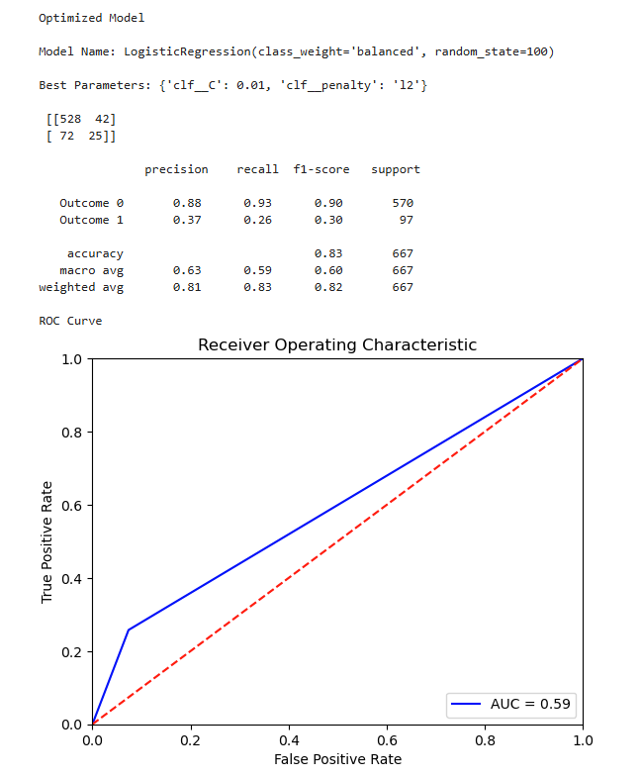
Classification Report Analysis for Optimized Models
Key Insights for Logistic Regression: Precision and Recall for Outcome 0 Precision (0.88): The precision for Outcome 0 is high, meaning that when the model predicts Outcome 0, it is correct 88% of the time. This reduces false positives, making the model reliable for predicting the majority class. Recall (0.93): The model also achieves excellent recall for Outcome 0, correctly identifying 93% of all true cases of this class. The combination of high precision and recall results in an impressive F1-score of 0.90, making it well-suited for applications where Outcome 0 is the focus.

Slide 12
Classification Report Analysis for Optimized Models
Key Insights for Logistic Regression: Precision and Recall for Outcome 1 Precision (0.37): The precision for Outcome 1 is relatively low at 37%. This means the model struggles with false positives, predicting Outcome 1 incorrectly in many cases. Recall (0.26): Recall is even lower at 26%, indicating that the model misses a significant portion of actual Outcome 1 instances. The low recall reflects poor sensitivity to the minority class, showing that the model does not perform well in identifying Outcome 1 cases. F1-Score (0.30): The low F1-score confirms that the model lacks balance in handling Outcome 1 predictions. This highlights a critical area for improvement, such as class-balancing techniques or feature engineering.

Slide 13
Classification Report Analysis for Optimized Models
Key Insights for Logistic Regression: Overall Performance Accuracy (83%): The model achieves a high accuracy of 83%, largely driven by its strong performance for the majority class (Outcome 0). However, this metric alone can be misleading in imbalanced datasets, as it may overemphasize the performance of the dominant class. Macro Avg F1-Score (0.60): The macro average F1-score is 0.60, reflecting an imbalance in class performance. While the model performs well for Outcome 0, its poor handling of Outcome 1 pulls down the macro average. Weighted Avg F1-Score (0.82): The weighted average F1-score is higher due to the larger support for Outcome 0. This metric reflects the dominance of the majority class in the dataset.

Slide 14
Classification Report Analysis for Optimized Models
Key Insights for Logistic Regression: ROC and AUC AUC (0.59): The AUC is 0.59, which is slightly worse than Naive Bayes (0.61). This low value shows limited ability to distinguish between classes, indicating room for improvement. ROC Curve Analysis: The ROC curve is close to the diagonal line, demonstrating weak discriminatory power. Despite a higher accuracy overall, the model’s capacity to separate classes effectively remains poor. Techniques like resampling, class weighting, or hyperparameter tuning may help improve the model's performance.

Slide 15
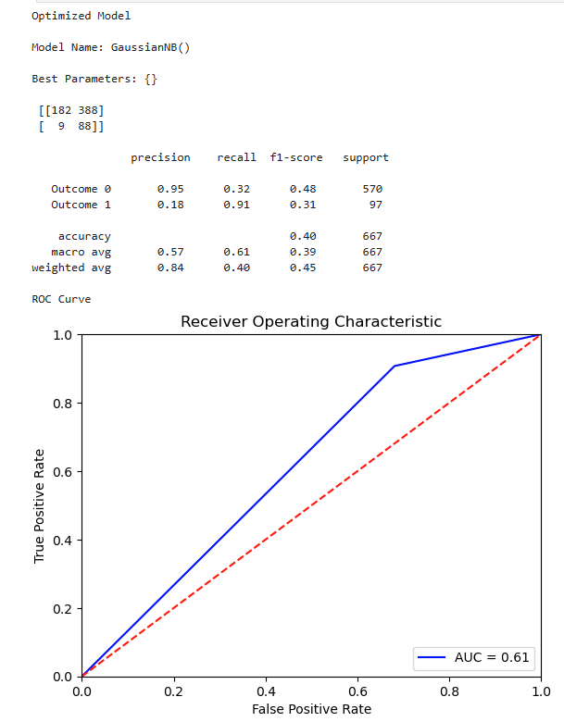
Classification Report Analysis for Optimized Models
Key Insights for Naïve Bayes: Precision and Recall for Outcome 0 Precision (0.95): The model demonstrates excellent precision for Outcome 0. This means when the model predicts Outcome 0, it is correct 95% of the time. This high precision reduces false positives for Outcome 0, which is beneficial for applications where incorrect predictions for Outcome 0 must be minimized. Recall (0.32): Despite the high precision, the recall is significantly low at 32%. This suggests that the model fails to identify a large portion of actual Outcome 0 instances. Many true cases of Outcome 0 are being missed, making the model unsuitable if capturing all instances of Outcome 0 is critical.

Slide 16
Classification Report Analysis for Optimized Models
Key Insights for Naïve Bayes: Precision and Recall for Outcome 1 Recall (0.91): The model performs exceptionally well in identifying actual instances of Outcome 1, achieving a recall of 91%. This means the model detects most Outcome 1 cases, making it highly sensitive to this class. Precision (0.18): However, the precision is only 18%, indicating that a large proportion of predicted Outcome 1 cases are false positives. This imbalance shows the model sacrifices precision for recall in this class, making it unreliable when false alarms for Outcome 1 are costly.

Slide 17
Classification Report Analysis for Optimized Models
Key Insights for Naïve Bayes: Overall Performance Accuracy (40%): The overall accuracy is very low, at 40%, which indicates poor overall performance in correctly predicting both Outcome 0 and Outcome 1. This low accuracy is primarily due to the imbalanced performance across the two outcomes. Macro Avg F1-Score (0.39): The macro average F1-score reflects the harmonic mean of precision and recall across both outcomes. Its low value (39%) confirms that the model struggles to balance prediction quality for both classes, highlighting severe performance disparity.

Slide 18
Classification Report Analysis for Optimized Models
Key Insights for Naïve Bayes: ROC and AUC AUC (0.61): The Area Under the Curve (AUC) is 0.61, which is slightly above random guessing (0.5). This indicates limited ability to distinguish between the two classes effectively. The small AUC value highlights the model’s suboptimal classification ability. ROC Curve Analysis: The ROC curve stays close to the diagonal line, further demonstrating the limited discriminatory power of the model. This suggests the need for more sophisticated feature engineering or alternative model choices.

Slide 19

Performance of the Voting Model
The VotingClassifier aggregates the predictions of multiple models to improve overall performance. For this case:
VotingClassifier Accuracy (0.84): The ensemble model achieves the highest accuracy among the three models, outperforming both Logistic Regression (0.76) and Random Forest (0.82).
Key Advantage: The VotingClassifier benefits from combining the strengths of its individual models, leading to more reliable and accurate predictions. By leveraging the diversity of predictions from Logistic Regression and Random Forest, it mitigates weaknesses in any single model.
Key Insight: The VotingClassifier is particularly useful in scenarios where individual models exhibit complementary strengths, making it a robust choice for improving overall performance.

Slide 20
Comparison with Logistic Regression
Logistic Regression Accuracy (0.76): Logistic Regression performs well in balanced datasets but struggles in this case due to its inability to effectively handle class imbalances.
VotingClassifier Advantage: The VotingClassifier boosts performance by combining Logistic Regression's linear decision boundary with Random Forest's non-linear capabilities.
Key Takeaway: Ensemble methods like VotingClassifier can outperform simpler models like Logistic Regression, especially in datasets with diverse feature relationships.

Slide 21
Comparison with Naïve Bayes
Gradient Boost Contribution: Gradient Boost, with its accuracy of 0.82, significantly improves over Naive Bayes and complements the VotingClassifier by capturing non-linear patterns. VotingClassifier Advantage: By combining the strengths of Random Forest and Logistic Regression, the VotingClassifier enhances both linear and non-linear decision-making, achieving the highest accuracy (0.84). Key Insight: The VotingClassifier demonstrates the power of ensemble learning, outperforming individual models by combining their strengths while mitigating their individual weaknesses.

Slide 22
Recommendations for Mr. John Hughes
Recommended Model: Voting Ensemble Justification: The Voting Ensemble model achieves the highest accuracy (0.84) among all models. By combining Logistic Regression and Random Forest, it balances the strengths of linear and non-linear methods, offering robust performance across diverse data patterns. Its superior predictive performance compared to Logistic Regression (0.76) and Naive Bayes (0.40) makes it the most reliable choice for practical deployment, ensuring higher accuracy in real-world use cases. Why Mr. John Hughes Should Use This Model: The Voting Ensemble provides a balance between interpretability (due to Logistic Regression) and advanced decision-making capabilities (from Random Forest). It is an ideal choice for applications where both precision and generalizability are critical.

Slide 23
Next Steps to Enhance the Voting Ensemble Model
Optimize Model Hyperparameters To further improve the Voting Ensemble’s performance, it’s essential to tune the hyperparameters of the individual models and the ensemble itself. This can involve: Logistic Regression: Optimize parameters such as the regularization strength (C) and penalty type (l1 or l2). For example, increasing or decreasing the penalty might strike a better balance between underfitting and overfitting. GradientBoosting: Adjust parameters such as the number of trees (n_estimators), maximum tree depth (max_depth), and minimum samples per leaf (min_samples_leaf). For instance, increasing the number of trees may improve stability and accuracy. Voting Ensemble Strategy: Experiment with different voting methods (e.g., soft voting for probability averaging vs. hard voting for majority class decision). Why This Matters: Hyperparameter tuning can significantly boost the performance of the ensemble by ensuring that the individual models are optimized to complement each other effectively. This results in higher accuracy, better generalizability, and reduced risk of overfitting.

Slide 24
Next Steps to Enhance the Voting Ensemble Model
Address Class Imbalance One of the key challenges in the dataset is the imbalance between Outcome 0 and Outcome 1. The minority class (Outcome 1) is underrepresented, leading to lower recall and precision for this class. The following steps can address this: Synthetic Minority Over-sampling Technique (SMOTE): Generate synthetic data points for the minority class to balance the dataset. This helps the model learn patterns related to the minority class more effectively. Class-Weight Adjustments: Modify the class_weight parameter in Logistic Regression or Random Forest to assign higher importance to the minority class. This ensures the model penalizes errors in predicting the minority class more heavily. Custom Threshold Optimization: Adjust the decision threshold for classification based on the probability outputs to prioritize recall or precision for the minority class, depending on the use case. Why This Matters: By addressing class imbalance, the model’s ability to correctly identify and predict the minority class improves. This leads to better recall, F1-scores, and overall usability in applications where predicting the minority class is critical.

Slide 25

Thank you!

